Slide 1

SmartAgro: Mitigating Post-Harvest Losses in Ghana
AN INTEGRATED DIGITAL MARKETPLACE WITH AI & ESCROW
1
Team Soft Touch: Mohamed (Backend/Product -Owner), Sam (Backend/Scrum-Master), Nicole (Frontend), Michael (FrontEnd/Design)

Slide 2

The Problem Context
The $1.9 Billion Annual Loss
Ghana loses 30-40% of agricultural produce annually due to post-harvest losses. (WFP)
Root Cause: Market Coordination Failure. Farmers cannot find buyers in time.
The Gap: Exploitative middlemen leverage information asymmetry to distort prices.
Related work: Existing agri-platforms (Esoko, Farmerline) improve price discovery but fail to address payment security, offline access, advisory support, and dual-role farmer participation.
2

Slide 3

Discovery Phase (Double Diamond)
Smallholder Farmer
Aggregator (Middleman)
Buyer
Find buyers quickly to reduce post-harvest losses
Sell produce at fair, transparent market prices
Receive localized farming advice despite limited internet access
Source produce from multiple farmers efficiently
Earn value through logistics and coordination, not price exploitation
Operate transparently within platform pricing constraints
Access fresh produce directly from farmers
Pay securely and avoid failed or risky transactions
See transparent pricing without middleman inflation
3

Slide 4

Our Hypothesis
We hypothesized a three-pillar solution:
Trust: Automated Escrow system to replace risky cash-on-delivery.
Access: Offline-First Progressive Web App (PWA) for remote connectivity.
Intelligence: Multimodal AI Agent for real-time farming advice.
Intelligence
Trust
AI agent provides real-time farming advice.
Escrow system enhances buyer-farmer trust.
Access
Offline-first app ensures accessibility for farmers.
4

Slide 5
Requirements
Using ISO/IEC/IEEE 29148 Standard
Functional Requirements
FR-01: The system shall be a Progressive Web App (PWA) capable of being installed on mobile devices without an app store.
FR-05: Buyers and Aggregators shall be able to search for products by location.
FR-08: Funds must be held in Escrow and released only after the Buyer or Aggregator confirms successful pickup/delivery.
FR-09: System shall provide an AI Chat interface (via OpenRouter) that answers farming questions.
Nonfunctional Requirements
NFR-03: The system shall aim for 99.9% server availability during business hours.
NFR-04: Local storage (IndexedDB) must be used to persist user data if the network request fails.
NFR-06: Offline data stored on the device must be cleared if the user explicitly logs out.
5

Slide 6
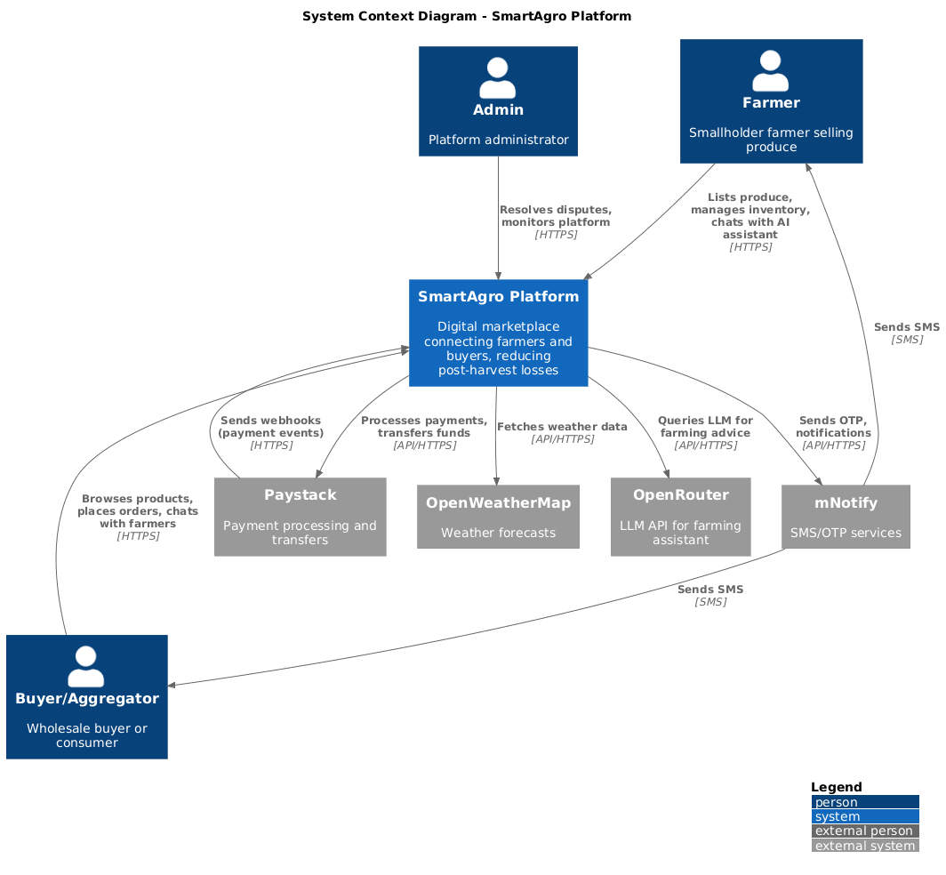
Architecture & Design
Modular Monolith design for efficient performance and scalability
Tech Stack:
Python/FastAPI (Backend)
React (Frontend)
PostgreSQL/MongoDB/Redis (Data).
Design Decision: Chosen over Microservices to reduce operational overhead for a 4-person team.
6

Slide 7
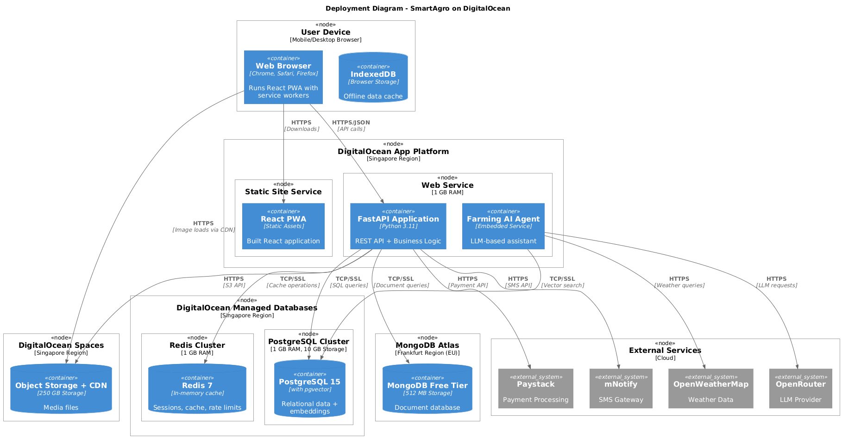
7

Slide 8
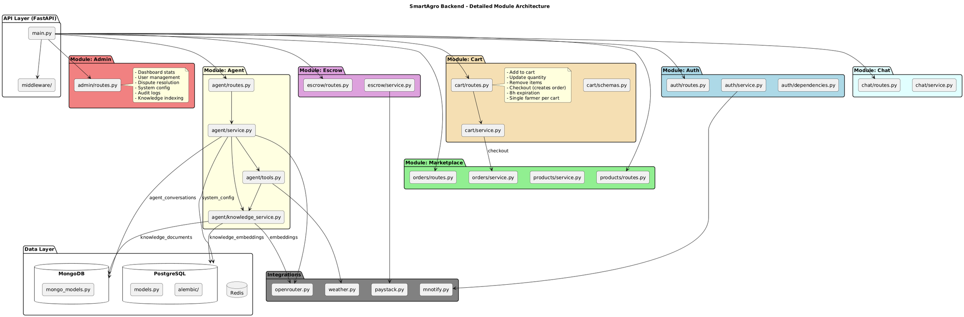
8

Slide 9
Escrow Logic: Ensuring Trust in Transactions
Integration with Paystack API.
Business Model: 95% payout to farmer, 5% platform sustainability fee.
Workflow: Buyer Pays -> Funds Held -> Delivery Confirmed -> Funds Released to Farmer.
9

Slide 10
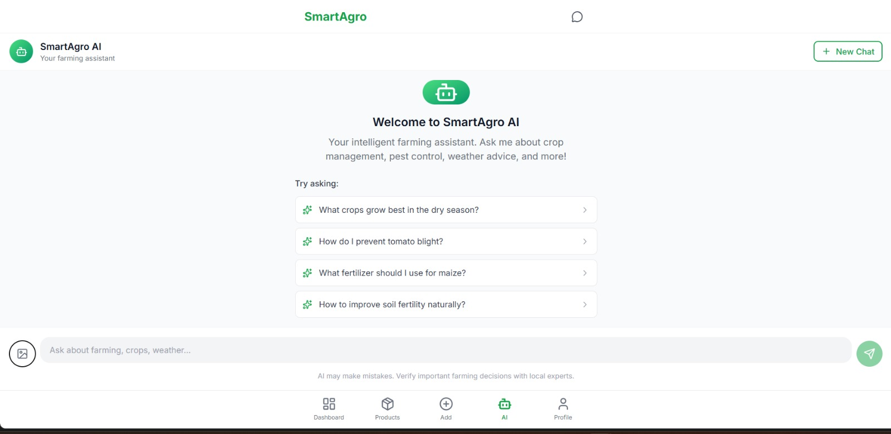
Intelligent Farming Assistant
Powered by Google Gemini (Multimodal LLM).
Capabilities: Agricultural and Profile Context-aware Advice.
Integrated with weather API for location-based forecasting.
10

Slide 11
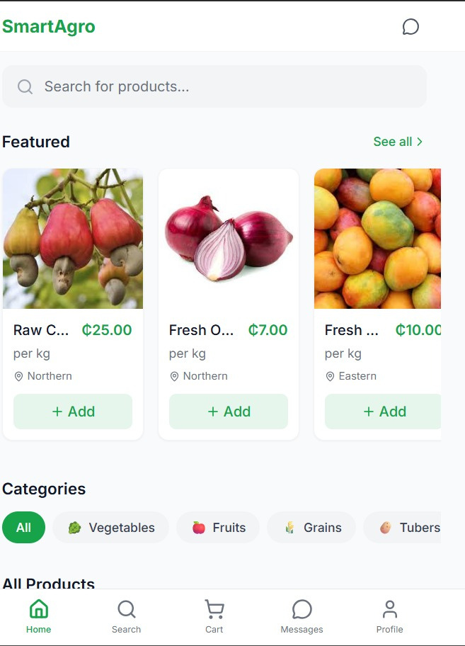
Engineered for Low Connectivity
Strategy: Progressive Web App (PWA) with Service Workers.
Offline Mode: Caches product feeds to allow usage in 2G/Edge network zones.
11

Slide 12
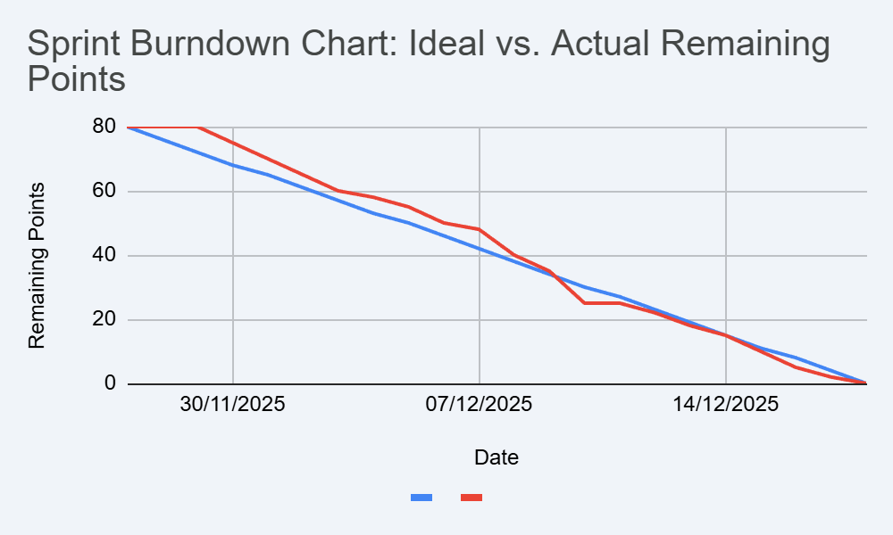
3-Week Agile Execution
Process: 1-Week Sprints (Planning -> Core Build -> Integration Crunch).
The Crunch: The Burndown chart reveals a high-complexity integration phase in Week 3 (AI/Integration and Deployment).
12

Slide 13
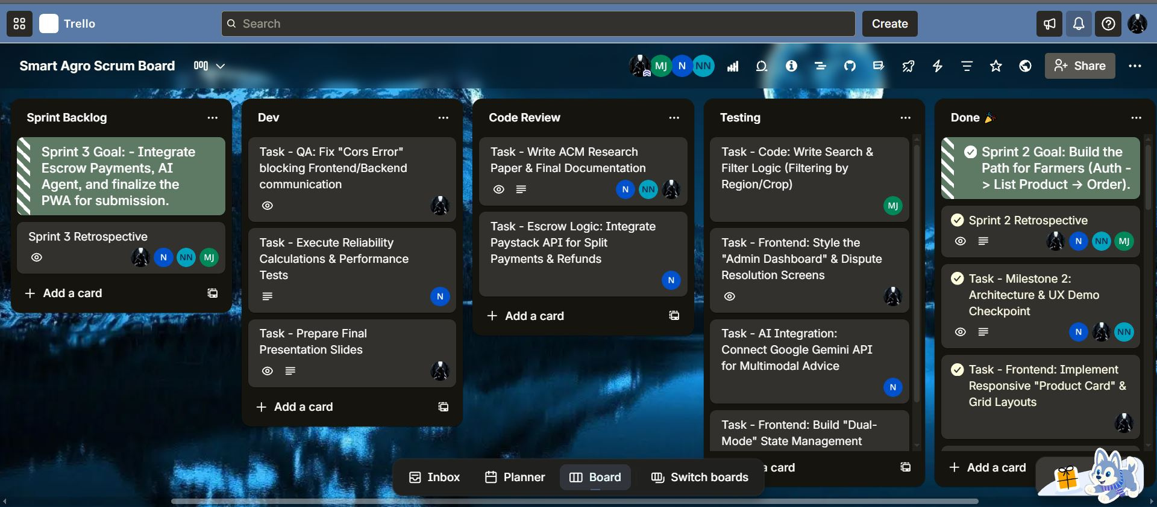
Agile Methodology in Action
Weekly Sprints
13

Slide 14
Live System Demo
Our Live Solution
14

Slide 15
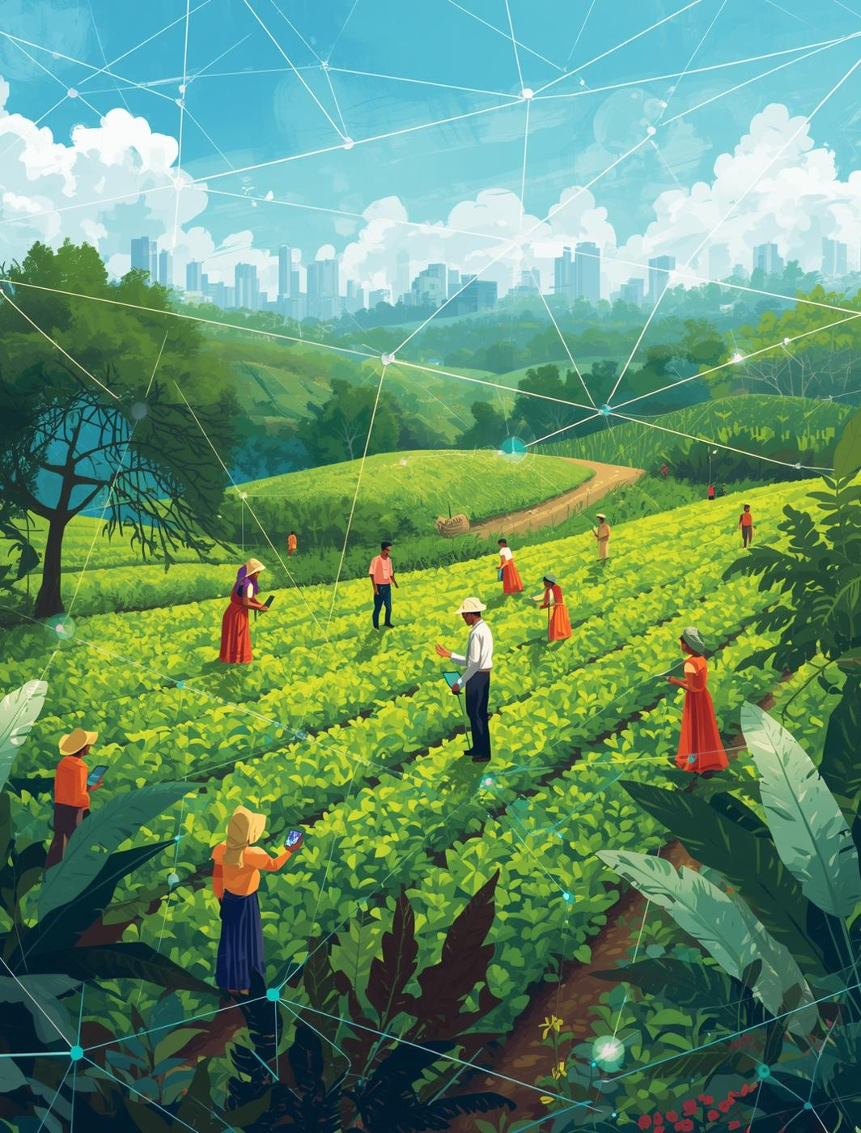
Conclusion
SmartAgro demonstrates how digital solutions tackle agricultural market coordination failures in Ghana. By utilizing AI and escrow systems, it helps farmers optimize operations, minimize losses, and improve market access, fostering a sustainable agricultural future.
15

Slide 16
References
Aker, J. C. 2011. Dial 'A' for agriculture: A review of information and communication technologies for agricultural extension in developing countries. Agricultural Economics 42, 6 (2011), 631-647.
Anthropic. 2024. Claude 3 Model Family: Sonnet, Opus, and Haiku. Technical Report. Anthropic PBC, San Francisco, CA.
Dittus, M., Quattrone, G., and Capra, L. 2016. Analysing Volunteer Engagement in Humanitarian Mapping: Building Contributor Communities at Large Scale. In Proceedings of the 19th ACM Conference on Computer-Supported Cooperative Work & Social Computing (CSCW '16). ACM, New York, NY, 108-118.
FastAPI. 2024. FastAPI Framework Documentation. Retrieved December 2025 from https://fastapi.tiangolo.com
Fowler, M. 2014. Microservices: A definition of this new architectural term. Retrieved December 2025 from https://martinfowler.com/articles/microservices.html
Government of Ghana. 2012. Data Protection Act, 2012 (Act 843). Accra: Ghana Publishing Corporation.
International Growth Centre. 2025. Market Coordination Failures in Ghanaian Agriculture. Policy Brief. International Growth Centre, London, UK.
Jensen, R. 2007. The digital provide: Information (technology), market performance, and welfare in the South Indian fisheries sector. The Quarterly Journal of Economics 122, 3 (2007), 879-924.
Ministry of Food and Agriculture Ghana. 2023. Agriculture in Ghana: Facts and Figures. Statistics Research and Information Directorate, Accra, Ghana.
Newman, S. 2015. Building Microservices: Designing Fine-Grained Systems. O'Reilly Media, Sebastopol, CA.
OpenAI. 2024. GPT-4 Technical Report. OpenAI, San Francisco, CA.
Paystack. 2024. Transfers API Documentation. Retrieved December 2025 from https://paystack.com/docs/transfers/single-transfers
React. 2024. React Documentation: Progressive Web Apps. Retrieved December 2025 from https://react.dev/learn
Roduner, D. 2007. Mobile Payment Procedures: Enabling Mobile Commerce. ETH Zurich, Institute of Technology Management, Zurich, Switzerland.
World Bank. 2024. Post-Harvest Loss Reduction in Sub-Saharan Africa: Challenges and Opportunities. Agriculture Global Practice, World Bank Group, Washington, DC.
16

